Slide 1
Health Information System
Modern Healthcare Data Management Solution
Django & React Implementation
25TH April 2025

Slide 2
Problem Statement & Approach
Problem:
Our Approach:
Healthcare data management inefficiencies
Disconnected program enrollment tracking
Security concerns in health information systems
Client-centered design
Secure, scalable web application
API-driven architecture
Real-time analytics

Slide 3
System Design (Architecture Design)
Three-tier architecture:
Design Principles:
Presentation Layer (React 19.0.0)
Business Logic Layer (Django 5.2)
Data Layer (MySQL/sqlite3)
Security by design
Responsive user experience
Modular component structure
RESTful API communication

Slide 4
Database Design
Entity Relationship Model:
User (authentication, roles)
Client (personal & medical data)
Program (health intervention details)
Enrollment (client-program relationship)

Slide 5
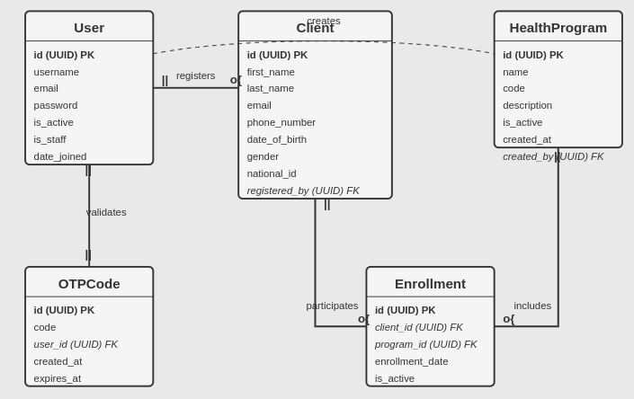
Data Flow Design:

Slide 6
Backend Solution
Django Implementation:
Security Features:
REST Framework (API development)
Token-based authentication
OTP verification system
Email notification service
Celery for asynchronous tasks
Password hashing
CORS/CSRF protection
Authentication middleware

Slide 7
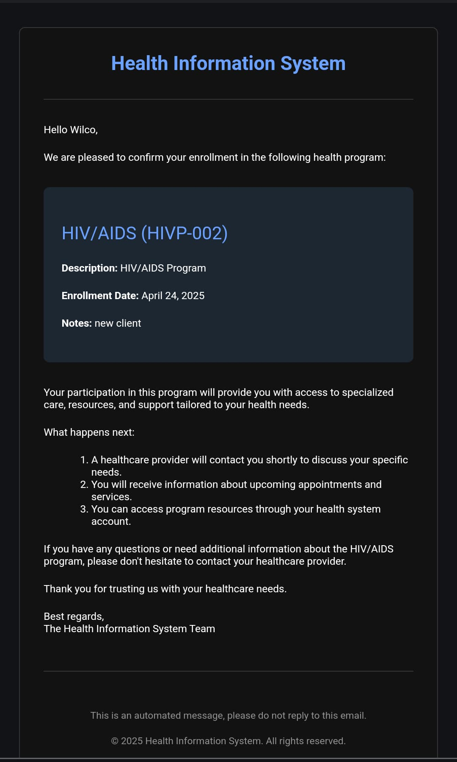
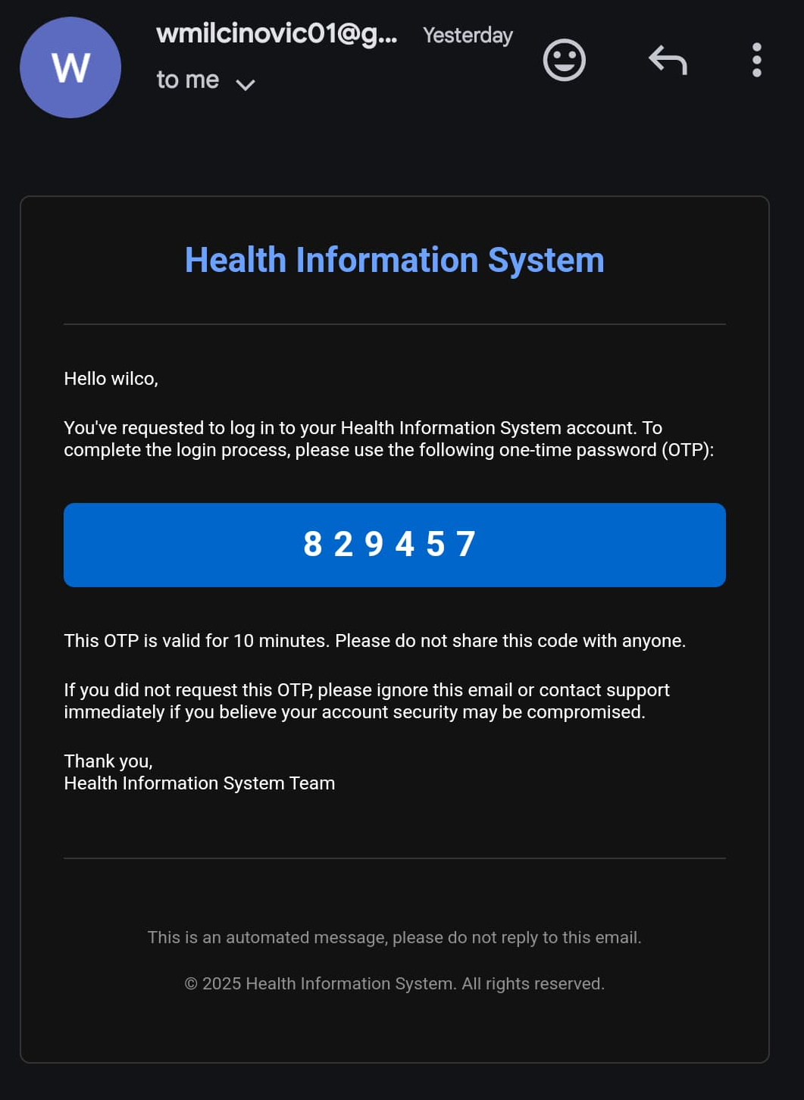
Emails Notifications

Slide 8
Frontend Solution
React Implementation:
User Interface Components:
Component-based architecture
Context API for state management
Protected routing
Form validation
Responsive design (Bootstrap 5)
Dashboard analytics (Chart.js)
Client management modules
Program tracking interface

Slide 9
Authentication Solution
Security Implementation:
Two-factor authentication flow
One-Time Password verification
Email delivery system
Token-based session management
Permission-based access control

Slide 10
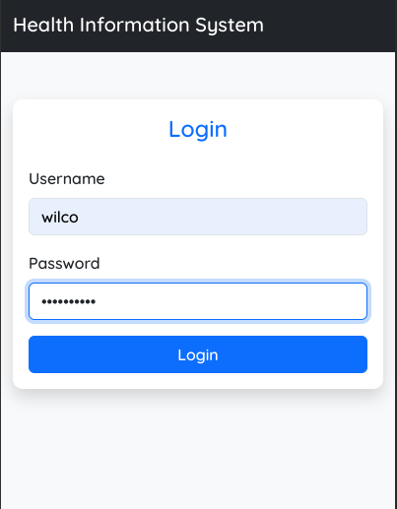
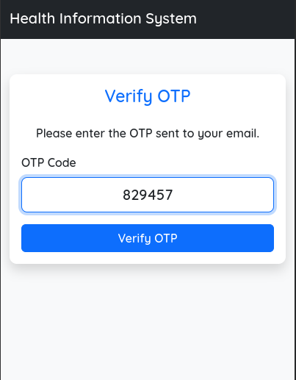
Login Process

Slide 11
Core Features Implementation
Client Management:
Program Management:
Registration workflow
Profile management
Search & filtering capabilities
Program enrollment process
Program creation interface
Enrollment tracking
Statistics visualization
Reporting capabilities

Slide 12
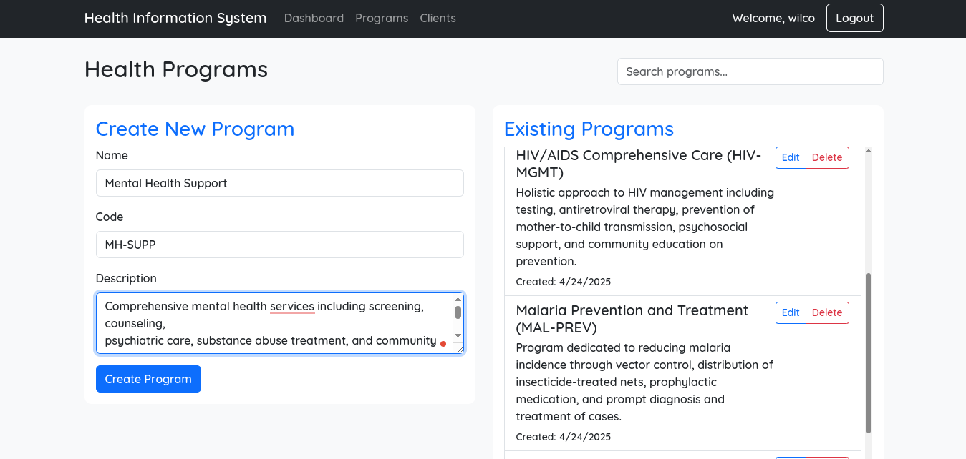
Program creation interface

Slide 13
Dashboard Solution
Analytics Implementation:
Real-time statistics
Client enrollment metrics
Program performance indicators
Data visualization components

Slide 14
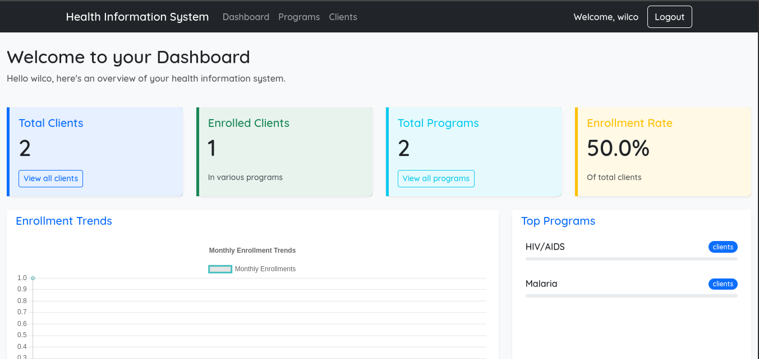
Dashboard

Slide 15
Deployment & Evolution
Deployment Solution:
Future Roadmap:
Production environment configuration
Database optimization
Static files serving
Web server implementation (Nginx/Apache)
SSL/TLS security
Mobile application development
Advanced reporting module
External API integrations
Telehealth capabilities

